Slide 1
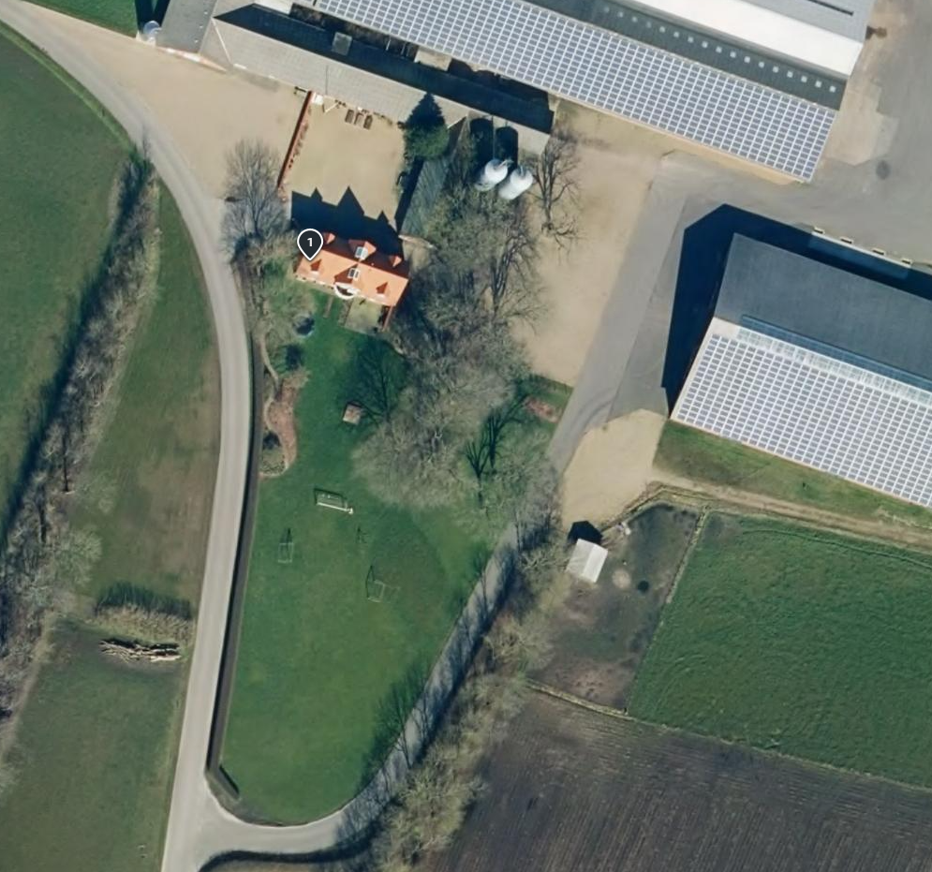
Parking Arla Innovation farm Klink - Holmgårdsvej 4, 6971 Spjald
Please only park in marked areas, to respect the daily work on the farm including big vehicles.
Entrance
Parking area

